Slide 1
Concurrency
Week 4
Race Conditions

Slide 2
Topics
Threads Communications
Shared Memory
Critical Section
Avoiding Race Conditions
Message Passing

Slide 3
Threads Communication

Slide 4
Concurrency (recap)
A concurrent program consists of a finite set of (sequential) processes.
The processes are written using a finite set of statements.
The execution of a concurrent program proceeds by executing a sequence of the statements obtained by arbitrarily interleaving the statements from the processes.

Slide 5
Communication
What we have practiced so far was only with:
disjoint threads: threads that do not communicate with each other
This week we will practice with threads communicating with each other

Slide 6
Communication
Concurrent processes* need to communicate:
share intermediate results
convey messages
* A process here is a general concept: A thread is a light weight process

Slide 7
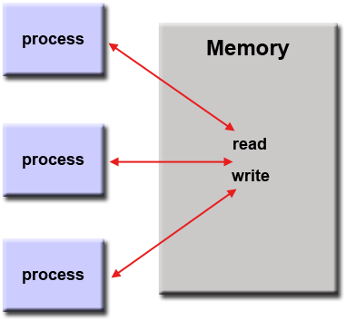
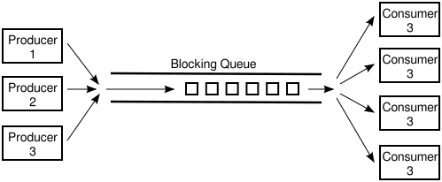
Communication
The most common ways of communication:
Shared memory: Parts of the memory is shared between processes
Main memory, a file, ...
Message Passing: Processes inform each other by communicating messages

Slide 8
Communication
First, we focus on shared memory and then, we will discuss message passing …
Shared memory:
how to achieve?
challenges?
solutions?

Slide 9
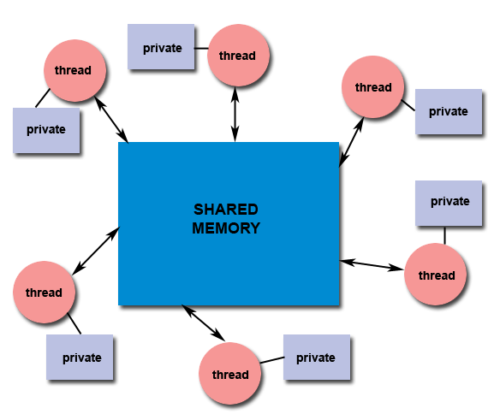
Shared Memory
Multiple explicit threads, each thread has access to:
private (pc, stack, local vars):
no access to other thread’s privates (local variables)
shared (heap):
threads can share objects
static fields are shared among objects.

Slide 10
Shared Memory
Multiple explicit threads, communicate through the shared memory:
writing values to a shared location to be read by another thread

Slide 11
Shared Memory
Q: Two threads are reading from a shared memory, is it safe?
Q: Two threads are reading and writing from/to a shared memory, is it safe?
Q: Two threads are writing to a shared memory, is it safe?

Slide 12
Shared resources need protection ...

Slide 13
Concurrency Pitfall
When two or more processes are reading or writing some values to a shared data, the final result depends on who runs when:
The order in which different threads access the shared memory is not deterministic.
The arbitrarily interleaving of the statements is assumed here.

Slide 14
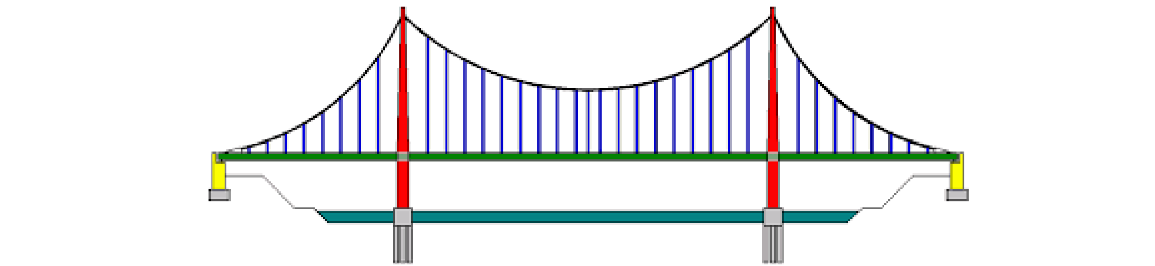
Example 1
Assume two observers at two ends of a bridge count the number of passing cars.
Each observer increments the value of a shared variable whenever it observes a car.

Slide 15
Example 1 (cont.)
Assume the shared variable is named total and is initialized to zero.
Sample code (CPU execution level) run by observers is:
Temp = read ( total )
Temp = Temp + 1
Store( Temp, total )

Slide 16
Example 1 (cont.)
Assume the current value of total is 12:
run the following execution steps
Process 2
Temp = read ( total )
Temp = Temp + 1
Store( Temp, total )
Process 1
Temp = read ( total )
Temp = Temp + 1
Store( Temp, total )
what is the value of total here?
Notes:
temp is playing the role of a register here ...

Slide 17
Example 1 (cont.)
Assume the current value of total is 12:
run the following execution steps
Process 2
Temp = read ( total )
Temp = Temp + 1
Store( Temp, total )
Process 1
Temp = read ( total )
Temp = Temp + 1
Store( Temp, total )
After two observations the value of total becomes 13 instead of 14

Slide 18
Example 2
An airline reservation system uses a list to keep track of the seats reserved/sold in each flight.
Two agents read the list
Both agents find out that seat 24 on flight ABC123 is available
The first agent reserves it by updating the list
The second agent overwrites the updated list reserving the seat for another passenger

Slide 19
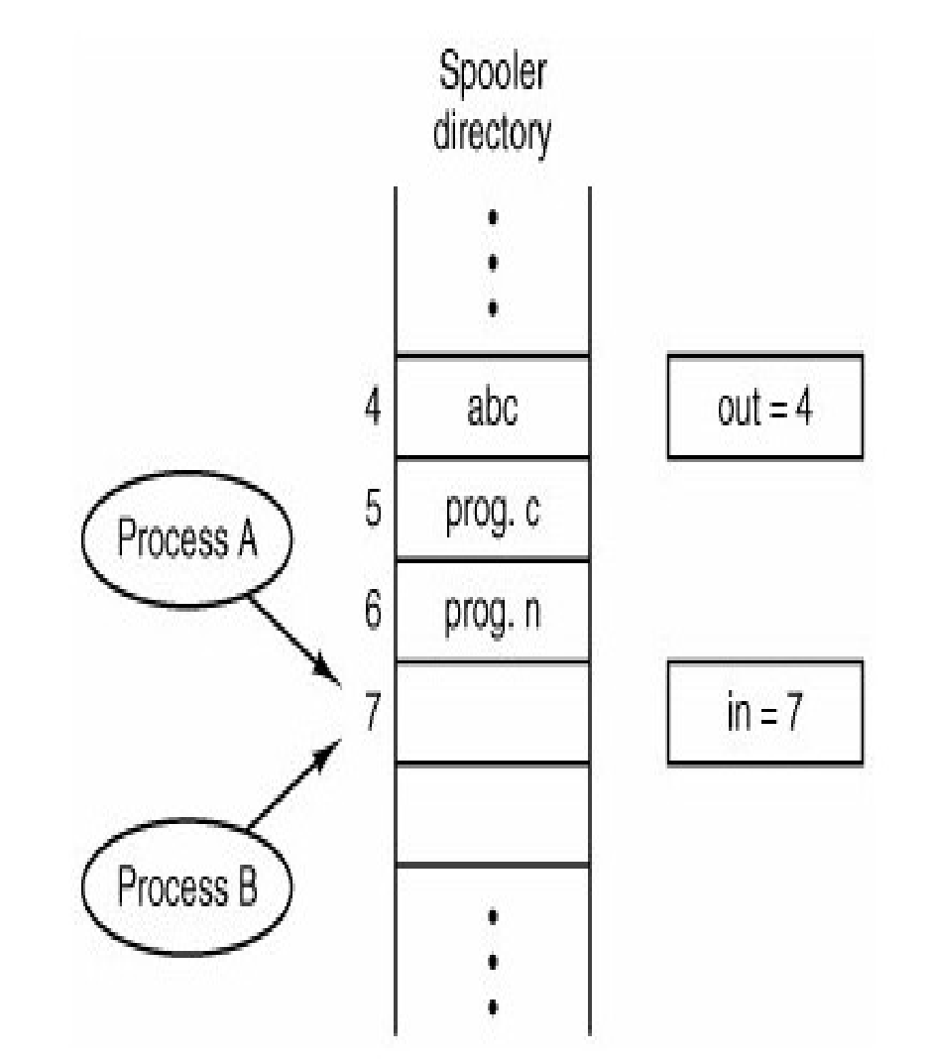
Example 3
A shared printer is used in a computer system.
The data sent by each process are stored at a shared location named a print spool.
The printer gets the next data item using index out
The processes uses index in to store their data in the print spool
Each process increments the value of index in after adding its data

Slide 20
Example 3 (cont.)
Process 1
Index = Read (in)
Store (data, Spool[index] )
Store (in, index + 1 )
As a result process 2 overwrites the data stored by process 1
Process 2
Index = Read (in)
Store (data, Spool[index] )
Store (in, index + 1 )

Slide 21
Race Condition
A race condition occurs when some processes or threads can access (read or write) a shared data variable simultaneously and at least one of the accesses is a write (data manipulation).
The result of the access in presence of race conditions may change each time that the code is run, as it depends on the order of access.

Slide 22
Critical Section
Each process has a segment of code, called critical section, in which the process may be changing shared data.

Slide 23
Critical Section (2)
Processes access shared resources only at a specific part of their codes.
Typical sequences are
Data = Read( )
Results = Process( data )
Write( Results, shared_locations )
Or
Data = Access( shared_locations )
Results = Process( Data )
Print( Results )

Slide 24
Avoiding race conditions...
To avoid race conditions we need to either
Avoid shared resources whenever possible
Avoid global variables
Or
Protect them: Apply locking and mutual exclusion principles

Slide 25

Avoiding Race Condition (cont.)
In order to avoid race condition:
If a process is in its critical section (using the shared resource), other processes should not be in their critical section (mutual exclusion).
mutual exclusion:
only one process can execute its critical section per time.

Slide 26
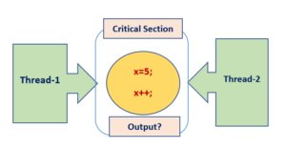
Avoiding Race Condition (cont.)
A process should be able to enter its critical section if no process is in its critical section.
No process should wait indefinitely to enter its critical section (starvation).

Slide 27

Mutex
Mutexes are used to put a lock on shared resources.
When a resource is locked, any process trying to access it will be blocked

Slide 28
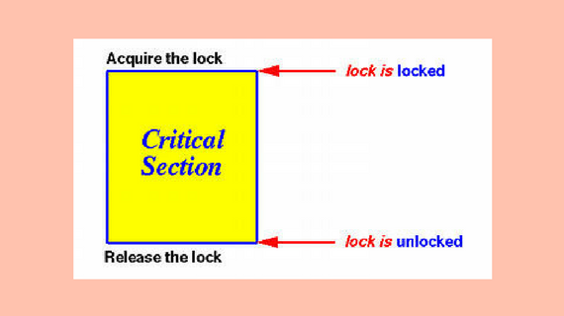
Mutex
Locking and unlocking should be implemented atomic operations (there will be no context switching before the operation is complete)
Function lock(mutex) and unlock(mutex) are used to lock and unlock a shared resource respectively.

Slide 29
Mutex: Example
Assume a library client wants to borrow a book. The steps can be shown as:
Mutex library
BookList = GetList( )
Item = Examine( BookList )
If available ( Item )
Borrow ( Item)
What is the shared resource here?
what is the critical section?
Notes:
I moved semaphores for week 5.

Slide 30
Mutex: Example
Assume a library client wants to borrow a book. The steps can be shown as:
Mutex library
BookList = GetList( )
Item = Examine( BookList )
If available ( Item )
Borrow ( Item)
How can we protect the critical section?
Notes:
I moved semaphores for week 5.

Slide 31
Mutex: Example
Assume a library client wants to borrow a book. The steps can be shown as:
Mutex library
BookList = GetList( )
Item = Examine( BookList )
Lock ( library )
If available ( Item )
Borrow ( Item)
Unlock ( library )
How can we protect the critical section?
Notes:
I moved semaphores for week 5.

Slide 32

Time to apply
Exercises Week 4: A , B. Follow the instructions from the exercises document.

Slide 33
Communication: Message Passing
In some concurrent environments, Shared-memory communication is not very effective.
For example, the standard programming model of Unix (Linux, etc.) was based on processes rather than threads.
Comparing to Windows-based systems, creating and running processes was cheaper

Slide 34
Communication: Message Passing
The major difference is that processes do not share any state.
Instead we can take the other major approach to manage concurrency, called message-passing.

Slide 35
Communication: Message Passing
In Week 2 we have discussed general message passing techniques between processes.
Can you name some?
Threads also can use message passing technique.
Programmers may need to implement and manage this technique.

Slide 36
Message Passing: How?
Two primary mechanisms are needed in a message-passing system:
A method of creating and specifying communication channels
A method of sending and receiving messages

Slide 37
Channel Specification
Direct naming: Sender and receiver directly name each other
Simple but less powerful
Not suitable for specification of client-server systems
The destination of messages are known in advance.
Example: Pipes
Port naming
Server use a single port to receive client requests
Sender and receiver do not need to know each other in advance
Simple, suitable for single server, multiple client systems
Example: Sockets
Global naming (mailbox)
Suitable for multiple server, multiple client systems

Slide 38
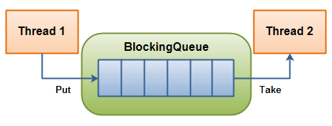
Message Passing: Producer-Consumer
Producer - Consumer: is a well-known model for message passing between threads.
There a channel: usually a buffer (a data structure)
Operations for send / receive
buffer
produce , send
receive ,consume

Slide 39
Message Passing: Producer-Consumer
Producer thread inserts (send/put/add) the data in the buffer.
Consumer thread takes (receive/take/remove) the data to use
buffer
produce , send
receive ,consume

Slide 40
Producer-Consumer: Example
Translating documents:
A set of documents to be translated
Functionalities: collecting, reading, language detection, translating, storing.
Doc.#x
Doc.#1
Doc.#y
Doc.#n-2
Doc.#n-1
Doc.#n
Doc.#2
Doc.#z
Doc.#3
Collecting from different sources, Reading
waiting to be processed
Language detection, Translations

Slide 41
Producer-Consumer: Example
Depending on the requirements and specification, we may consider more than just one solution:
Multiple-Documents, Multiple-Translators
Multiple-Documents, One-Translator
Doc.#x
Doc.#1
Doc.#y
Doc.#n-2
Doc.#n-1
Doc.#n
Doc.#2
Doc.#z
Doc.#3
Collecting from different sources, Reading
waiting to be processed
Language detection, Translations

Slide 42
Producer-Consumer Problem
Consider multiple producers and multiple consumers
Any producer’s output can be processed by any consumer
How producers and consumers are related?
Use port naming
Each process has a port
Won’t work since each producer needs to decide which consumer the produced item should be sent to
Not conform to the spec

Slide 43
Producer-Consumer Problem
Consider multiple producers and multiple consumers
Any producer’s output can be processed by any consumer
How producers and consumers are related?
Use a buffer manager
Assume only port naming is available
The manager manage a shared buffer
Similar to mailbox, but implements shared queue

Slide 44
Producer-Consumer Problem
Assume the solution based on buffer manager and port naming:
Challenge 1: Synchronization
How to synchronize the producers and consumers with the bounded buffer
Buffer full: Stop putting messages from producers
Buffer empty: Stop receiving messages from consumers

Slide 45
Producer-Consumer Problem
Solution based on buffer manager and port naming:
Challenge 2: Managing the buffer
(model solution, implementations might differ)
Manager needs two ports, one for consumers, one for producers
Otherwise, cannot block only consumers or only producers
Still have problem: How to read from two ports
Solution 1: Use blocking receive() and two threads
Manager cannot do blocked receive on both ports
Solution 2: Use non-blocking receive()
Poll two ports using BSNR (blocking send, non blocking receive)

Slide 46
Producer-Consumer: A Sample algorithm
Producer Process:
repeat
produce item;
send (dataport, item);
until false;
Consumer Process:
repeat
send (reqport, localport);
while not receive (localport, item) do nothing;
consume item;
until false;

Slide 47
Producer-Consumer Problem
Manager Process (blocking solution):
repeat forever
if count = 0 then
{ while not receive (dataport, item) do nothing;
put item in the queue; count := count + 1;
}
else if count = N then
{ while not receive (reqport, port) do nothing;
take item from queue; count := count - 1;
send (port, item);
}
else
{
if receive (dataport, item) then
{ put item in the queue; count := count + 1; }
if receive (reqport, port) then
{ take item from queue; count := count - 1;
send (port, item);
}
}

Slide 48
Time to apply
Exercises Week 4: C , D, E. Follow the instructions from the exercises document.

